Slide 1

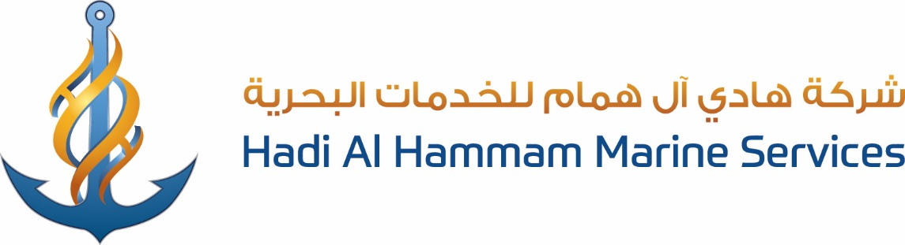



Slide 2
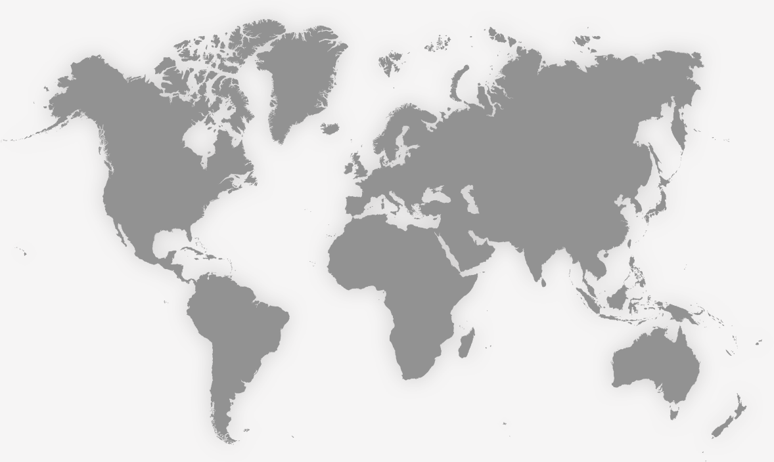
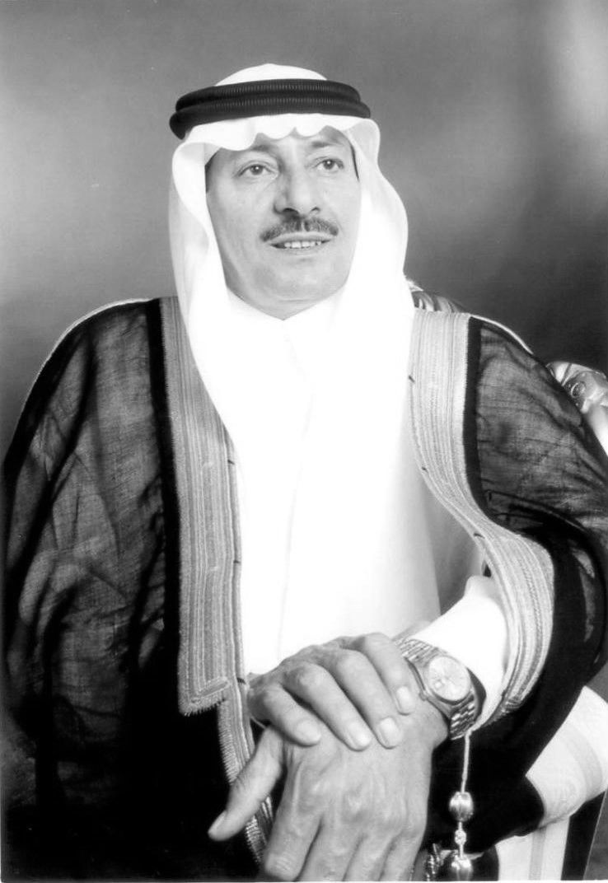
Hadi H. Al‐Hammam Establishment (HHE) was established in 1978 as a
proprietary Saudi Establishment, headquartered in Rahima, Saudi Arabia
with the objective of providing General Contracting services to the Oil &
Gas and petrochemical p Industries in particular, as well as to the private
industries and business establishments operating in the Kingdom of
Saudi Arabia.
Since its inception, HHE has systematically expanded its range of services
and acquired the necessary skills to provide diversified services most
efficiently and cost effectively.

Slide 3






Slide 4
Our business….
MARINE
COMMERCIAL
MAINTENANCE
CONTRACTING
Vessel Owner & Operator
Ship Handling
Catering & Agency Services.
Life Raft and Fire Extinguishers Servicing
Radio Survey
Calibration & Servicing of Gas Detection Systems.
Supply & Services source to Oil & Gas, Petrochemical, Power and other Industrial sectors.
Supply, Installation, commissioning and maintenance of Equipment & accessories.
Represents various manufacturers from USA, Europe and Asia in the kingdom
Plant T&I Shut-down Maintenance
Hydro-jetting Services
Industrial Waste Handling Services
Corrosion Protection Services
Equipment Rental
General construction work in the Oil & Gas, Power & Petrochemical Industries.
Including turnkey projects – Civil, Mechanical, Electrical and instrumentation.

Slide 5
Industrial Maintenance services
Adept Tank cleaning & sanitizing assignments, Tank repair, Pipeline maintenance.

Slide 6
Industrial waste handling services
Experienced sewage treatment, plant maintenance, Hydrocarbon waste handling & disposal with huge vacuum tanker and super sucker fleet.

Slide 7
Offshore maintenance services
Top notch Abrasive blasting, painting & metal services, full external – internal coating repairs & weather protection.

Slide 8
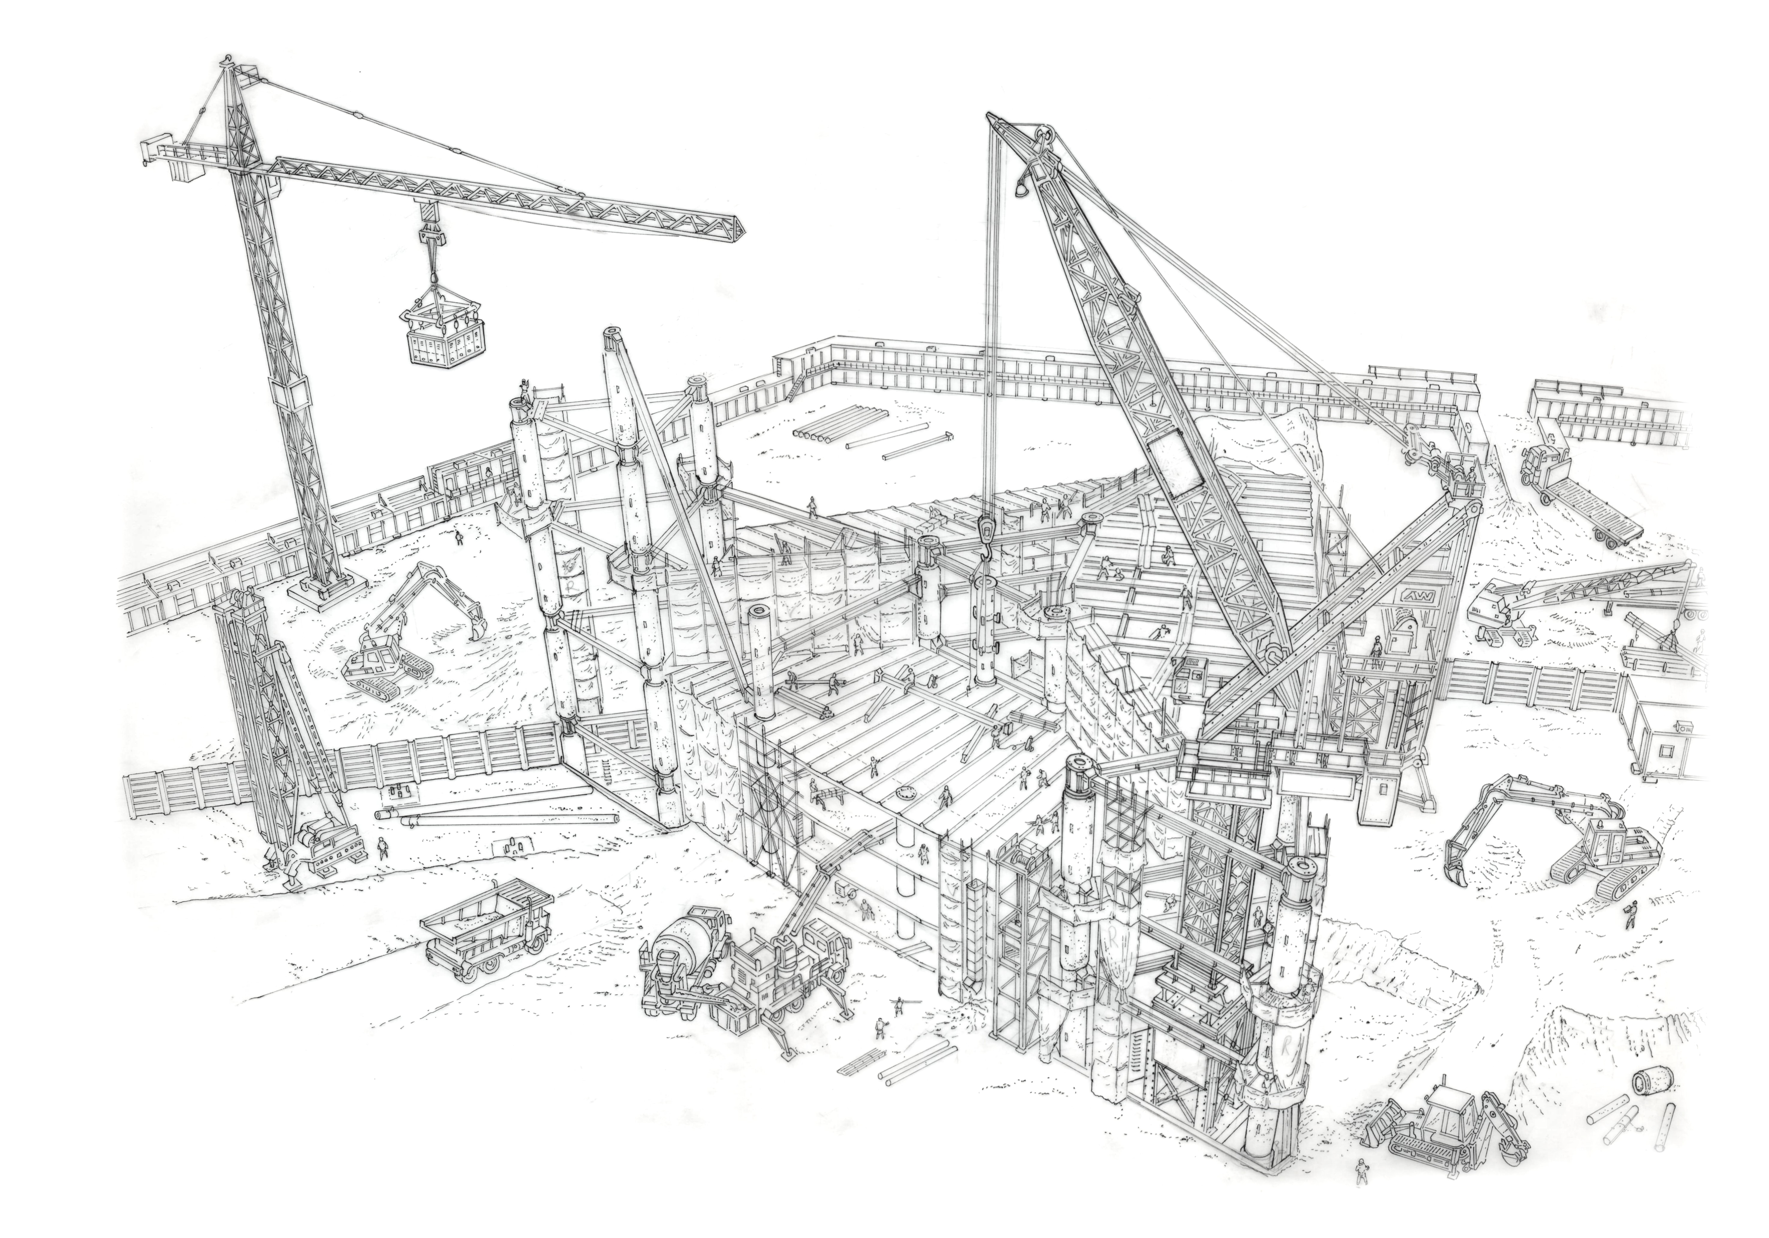
Corrosion protection services
Ultimate solutions for rust proofing, cathodic protection systems & critical coating.

Slide 9
Hydro jetting services
Supreme hydrojet cleaning of boilers, columns, heat exchangers, Fin Fan coolers, Cold cutting and concrete demolition.

Slide 10
Marine base support services
Professional marine work force operations performed in the Arabian gulf on marine crafts, jack-up barges, offshore platforms & GOSPs

Slide 11
Transport and equipments division
Huge asset base comprising of various small to heavy machinery & equipments capable of doing any large scale maintenance tasks.

Slide 12

HADI HAMAD AL HAMMAM TRADING CO. IS A WELL ESTABLISHED RELIABLE SUPPLY & SERVICES SOURCE TO OIL & GAS, PETROCHEMICAL, POWER AND OTHER INDUSTRIAL SECTORS PROVIDING SUPPLY, INSTALLATION, COMMISSIONING AND MAINTENANCE OF EQUIPMENT MANUFACTURERS IN THE USA, EUROPE AND ASIA. OUR LIST INCLUDES;
Heat Exchangers - Shell & Tube, Tube Bundle Tubes - Bare, Fined, Studded etc.
Pressure Vessels. Pipes and Pipe Fittings
Pumps & Spares Insulation & Refractory.
Flat Rolled Stainless Steel and other alloys Compressor Valves, Accessories - Special “CPI”. Gas & Steam Turbine Spare Parts. Connectors for Process Plants.
Chemicals – Drilling & Industrial. Cathodic Protection System & Devices.
Cable Trays & Glands. Electrical and Instrumentation Supplies.
High Performances Polymer System for Rebuilding and Resurfacing Filtration Equipment and Spares.
Marine Equipment and Spares. Hoses and Special Purpose Flexible.
Fire & Gas Detection Monitoring & Protection Systems and spares.

Slide 13









We represent….

Slide 14
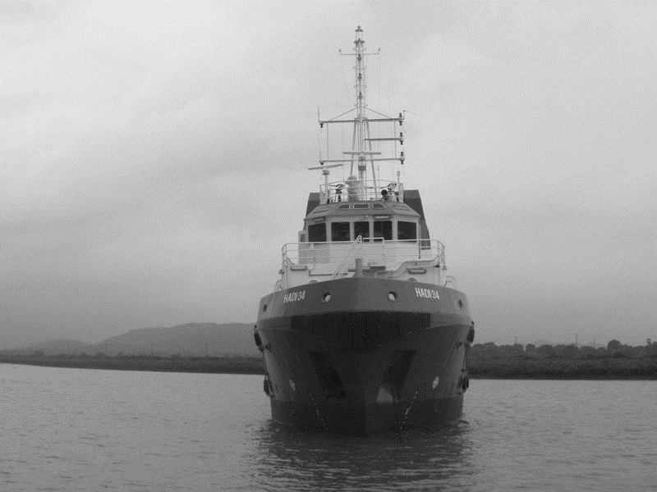
Hadi Hamad Al Hammam Marine Co. is an internationally focused marine service provider. With a state-of-the-art fleet of over 40 vessels ranging from AHTS, tug boats, safety vessels, offshore maintenance vessels to utility boats, we have been in service for 35 plus years. Our scope includes;
Vessel owner/ operator
Marine craft charter
Vessel maintenance, ship repair & offshore services
Marine brokers, ship agents & ship chandlers

Slide 15
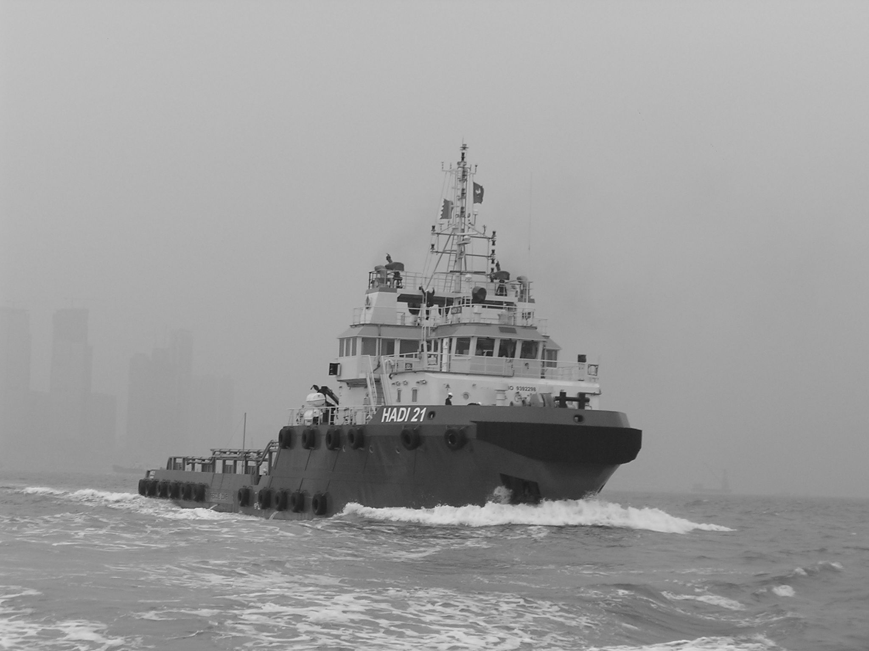
Anchor handling & tug supply boats

Slide 16
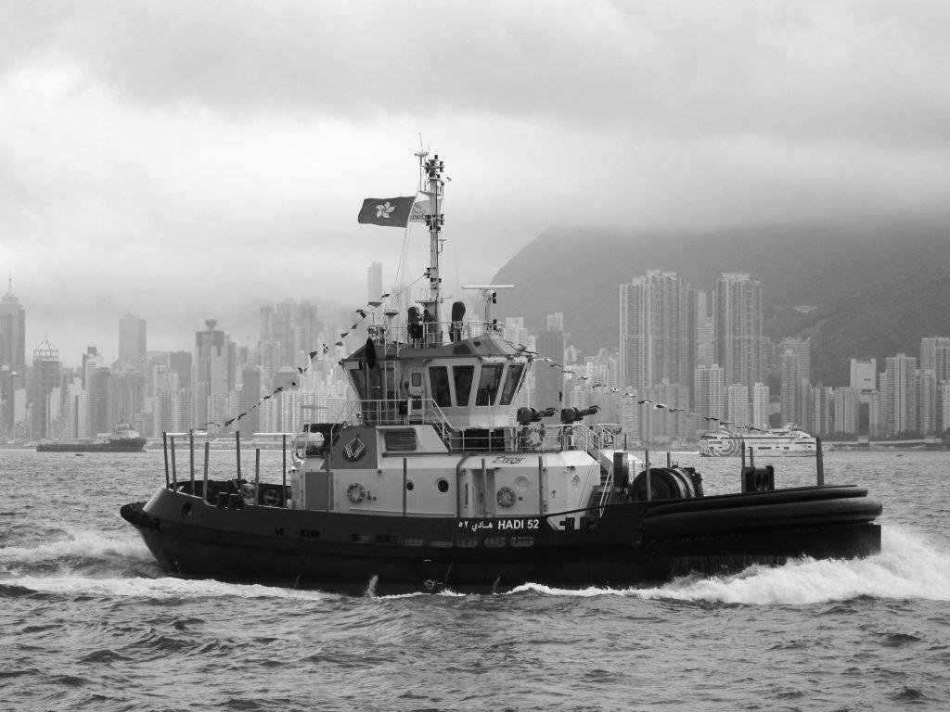
ASD tug & Pilot boats

Slide 17
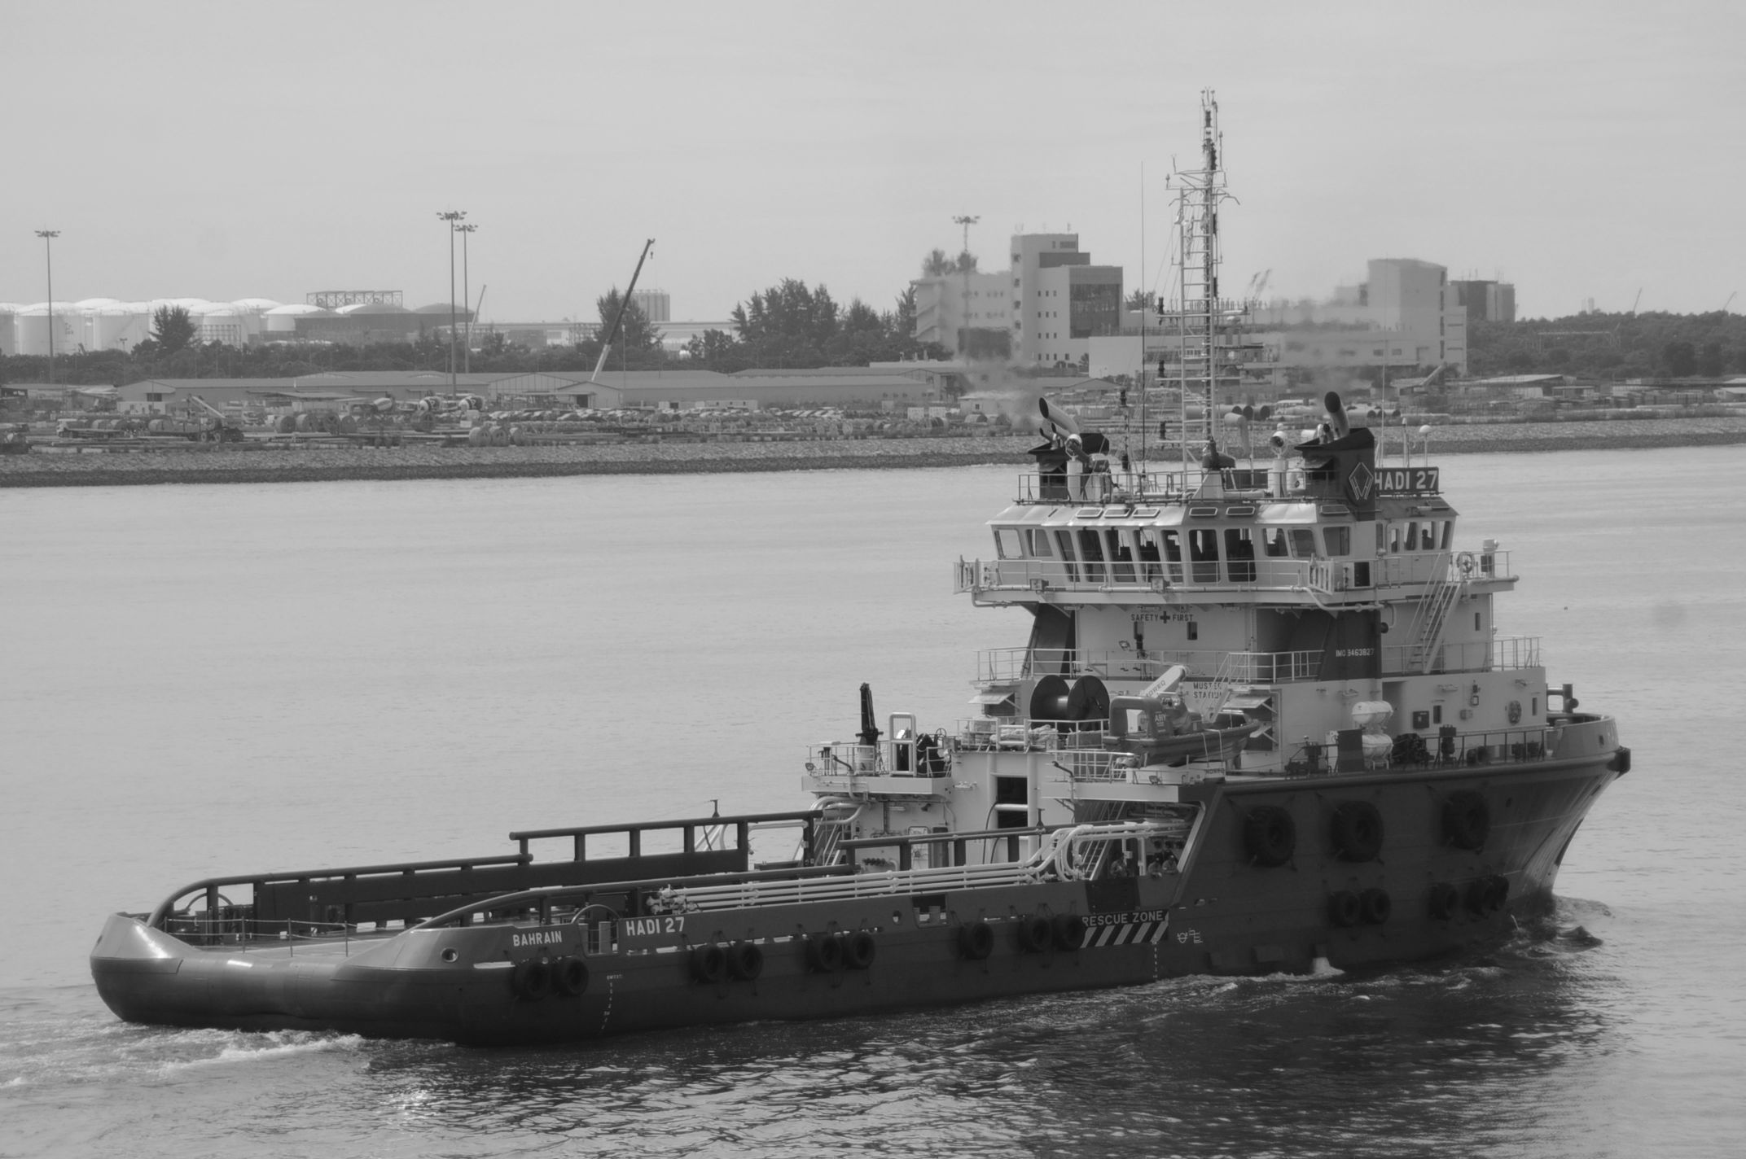
Maintenance vessels

Slide 18
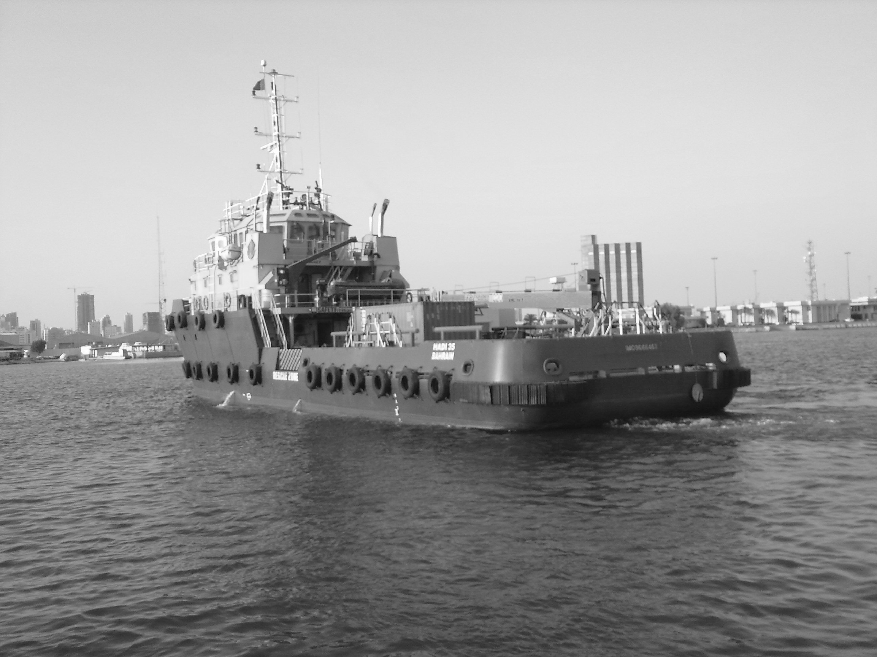
Offshore supply vessels

Slide 19
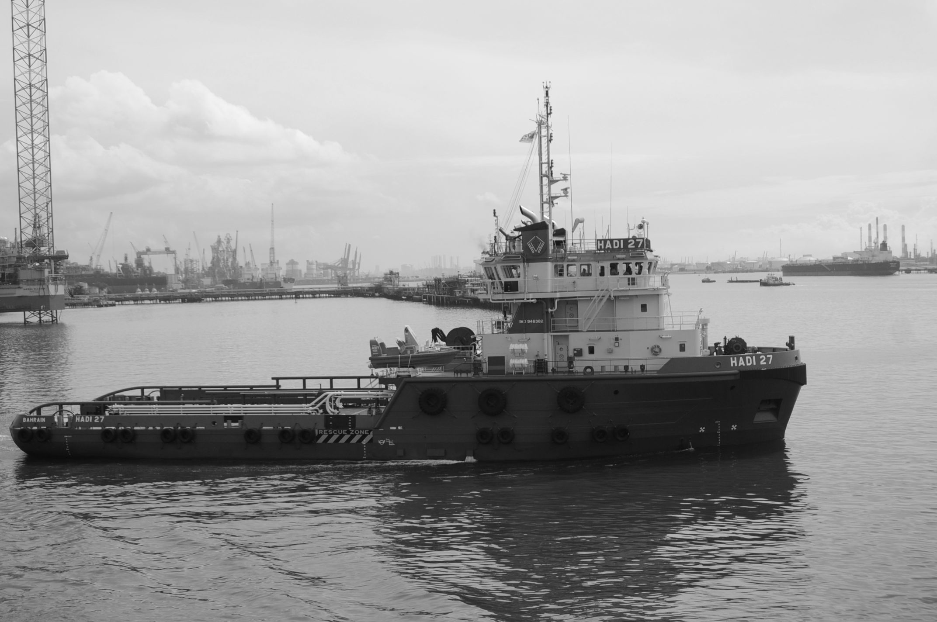
Utility vessels

Slide 20
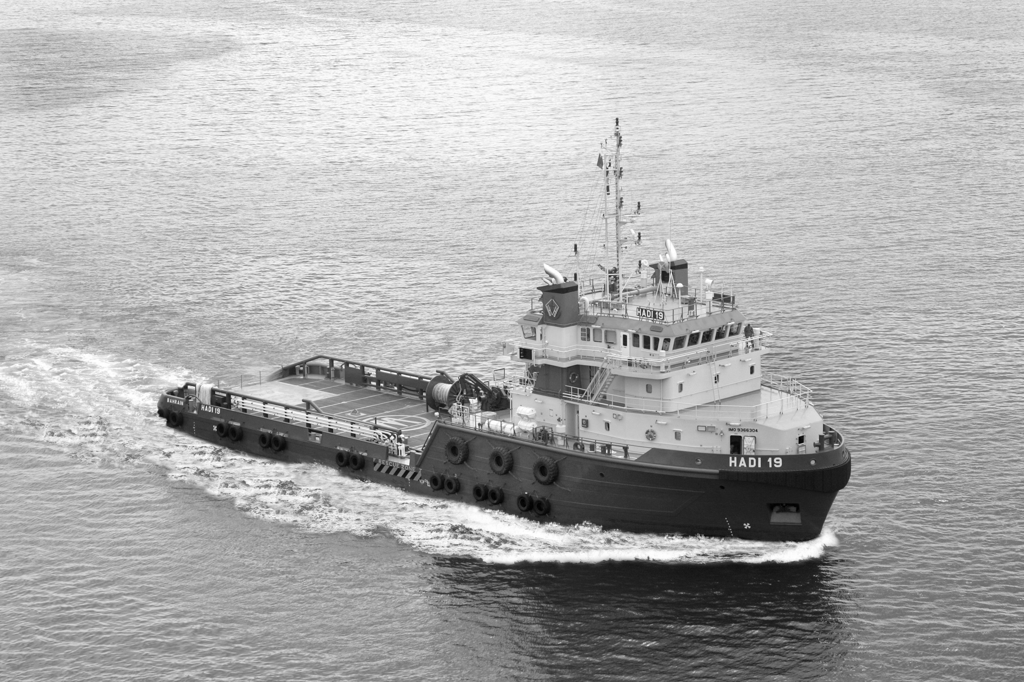
Marine services
Ship broking, vessel maintenance, offshore services, Ship agents & chandlers

Slide 21
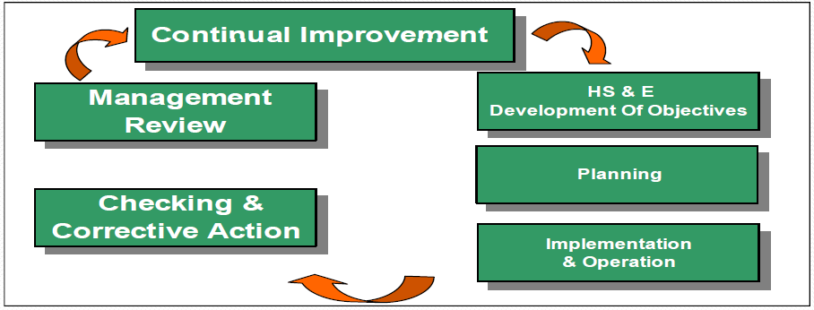
Safety policy & Assurance program
ZeroAccidents™
High level of safety awareness & implementation
Personnel safety responsibility
Safety training of workforce in advance
Stringent action to avoid recurrence

Slide 22
Awards & recognitions

Slide 23

Ras Tanura
Jubail
Jeddah
Riyadh
Tanajib
Yanbu
Abqaiq
Rabigh
Dubai
Bahrain
Srilanka
Singapore
www.hadihammam.com

